Slide 1

Adventure Works Cycles
Data Analysis
This presentation explores a data analysis project for Adventure Works Cycles, a multinational manufacturer of bicycles.

Slide 2
Project Overview
Adventure Works Cycles
Project Objectives
A multinational manufacturer specializing in metal and composite bicycles.
Perform comprehensive sales and production data analysis.
Headquarters: Bothell, Washington with 290 employees.
Derive actionable insights to aid decision-making.
Build dynamic dashboards to visualize findings.

Slide 3
Metrics Calculated
Sales Amount
Production Cost
Profit
Formula = (Unit Price × Order Quantity) - Discount.
Formula = Unit Cost × Order Quantity.
Formula = Sales Amount - Production Cost.

Slide 4
Data Sources
Q4
Q3
Q2
Fact Internet Sales
Product Sheet
Q1
Sum Of Sales Amount
Grand Total: 29358677.22
Product cost
Grand Total: 1925323.058

Slide 5
2024 Sales by month
January | 100,703 | July | 101,444
February | 97,427 | August | 95,539
March | 104,202 | September | 92,479
April | 103,324 | October | 104,608
May | 89,474 | November | 98,126
June | 97,159 | December | 107,081

Slide 6
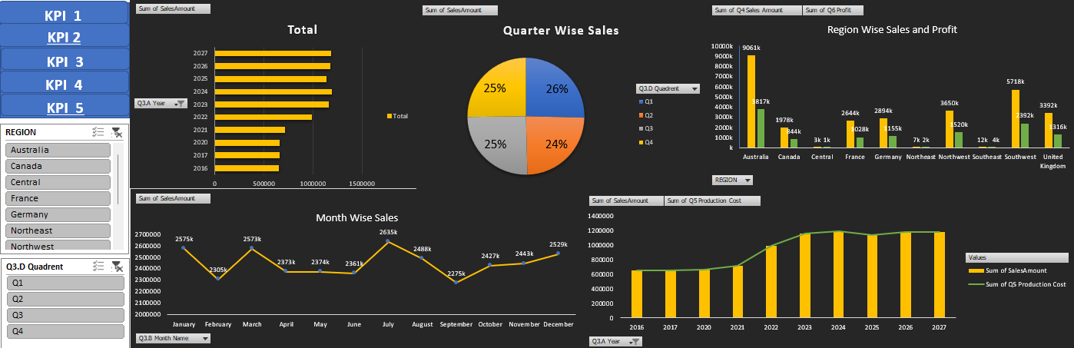
Visualizations in Excel

Slide 7
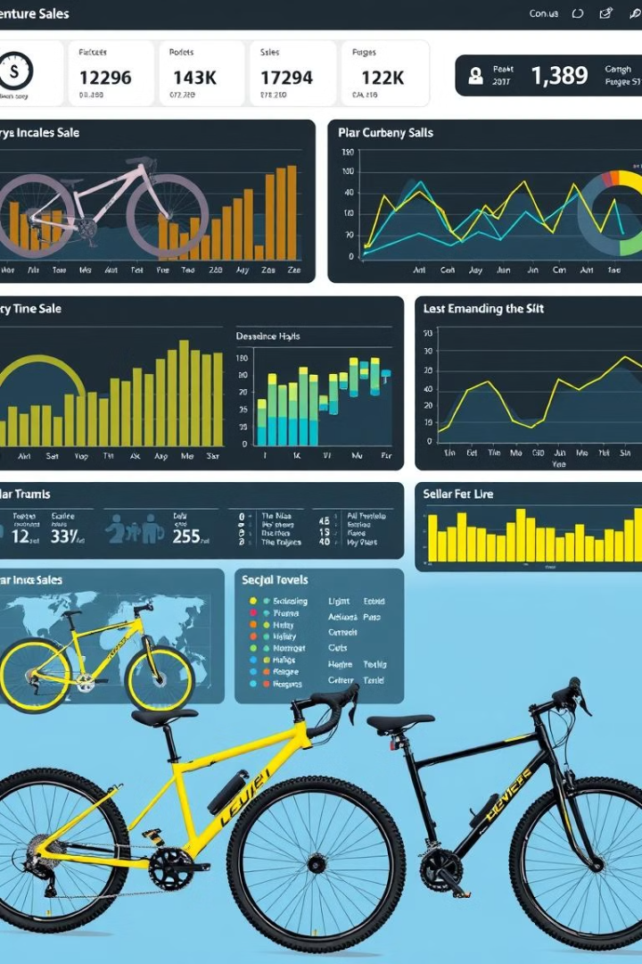



Dashboards in Power BI and Tableau
Product Performance Analysis
Identify high-performing products.
Customer Insights
Segmentation based on demographics.
Regional Analysis
Understand sales distribution across regions.

Slide 8
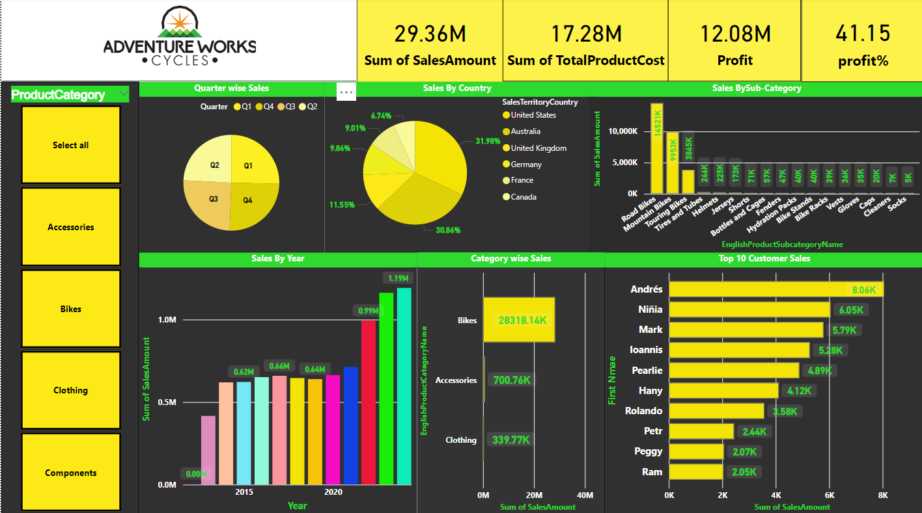
Visualizations in Power BI

Slide 9
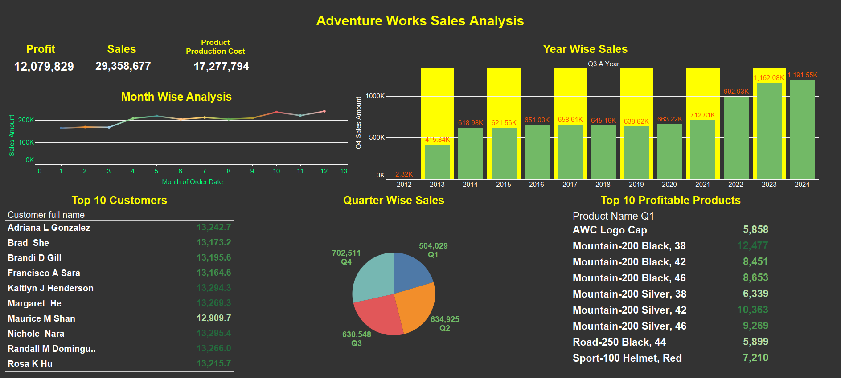
Visualizations in Tableau

Slide 10

Data Preprocessing
1
Union of Datasets
2
Lookup Operations
Combined Fact Internet Sales and Fact Internet Sales New.
Mapped Product Names and Unit Prices from Product Sheet.
3
Date Field Creation
Extracted temporal features like Year, Month, Quarter, and Weekday.

Slide 11
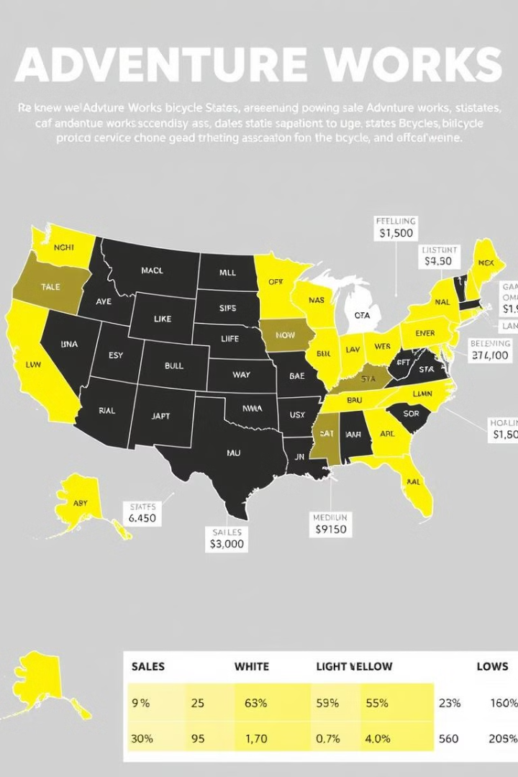
Key Findings
1
2
Yearly Trends
Profitability
Identified highest sales in specific year
Most profitable products and regions.
3
Customer Behavior
Key demographics contributing to sales growth.

Slide 12


Thank You

